Slide 1
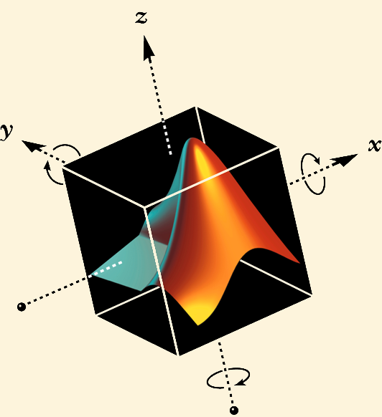
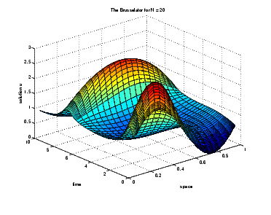
MATLAB tutorial online version
Methods in Computational Neuroscience
Obidos, 2004
Thanks to Oren Shriki, Oren Farber
and Barak Blumenfeld

Slide 2
Capabilities
Numerical calculations. Matrix manipulations.
MATLAB = MATrix LABoratory
Data Analysis
Data Visualisation
Simulations
Neuronal models
Network models
Analytical calculations
User interfaces
....
....

Slide 3
Starting MATLAB
Desktop Demo
type demo matlab desktop in the prompt ,and then start a „desktop environment“ demo

Slide 4
First steps. Learning by doing
Matrix Manipulations

Slide 5
Data analysis
Importing Data
type demo matlab desktop in the prompt ,and then start a „importing data“
Data Analysis Demo
Interpolation Demo

Slide 6
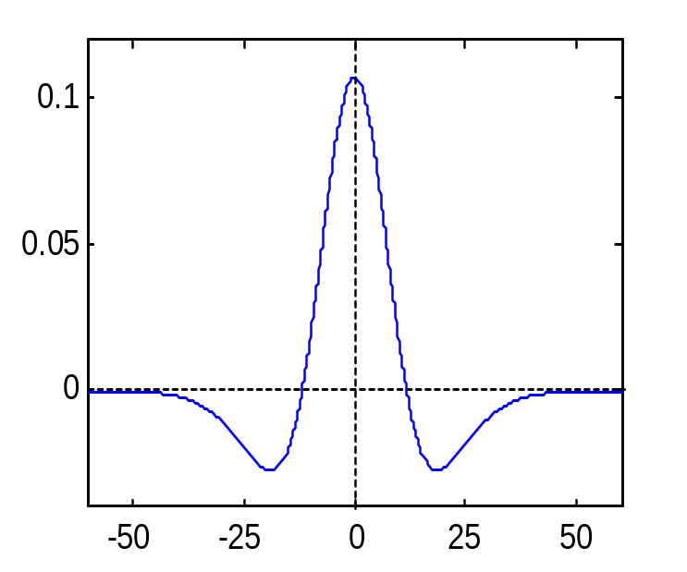
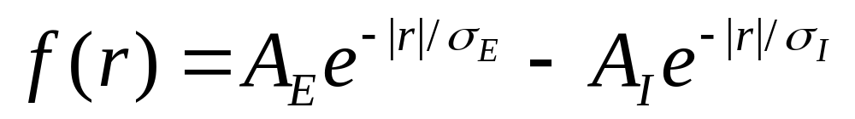
3-D plots
Mexican hat function

Slide 7
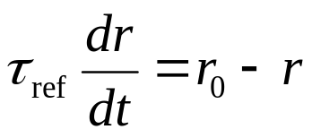
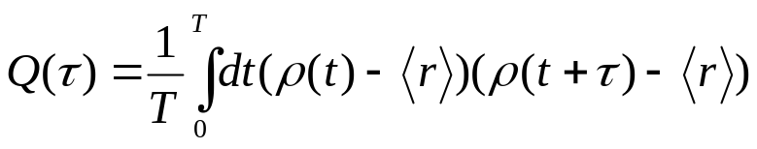
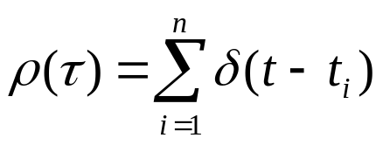
Poisson spike train generator
Exercise 3
Spike times: t_{i}
Interspike interval distribution: P[τ ≤ t_{i+1} - t_{i} < τ +Δt] = rΔt exp(rτ).
Formula for generation: t_{i+1} = t_{i} - ln(x_{rand})/r.
Relative refractory period:
Autocorrelation function

Slide 8
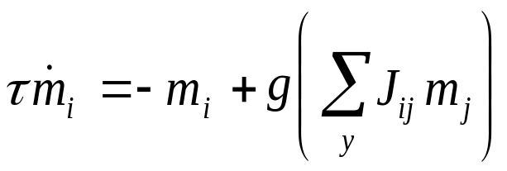
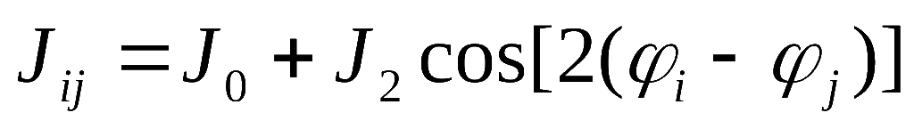
Ring neural network model
g(x)
T
Weak coupling with homogeneous input
Weak coupling with noisy tuned input
Strong coupling with noisy tuned input
Strong coupling with nonspecific input

Slide 9
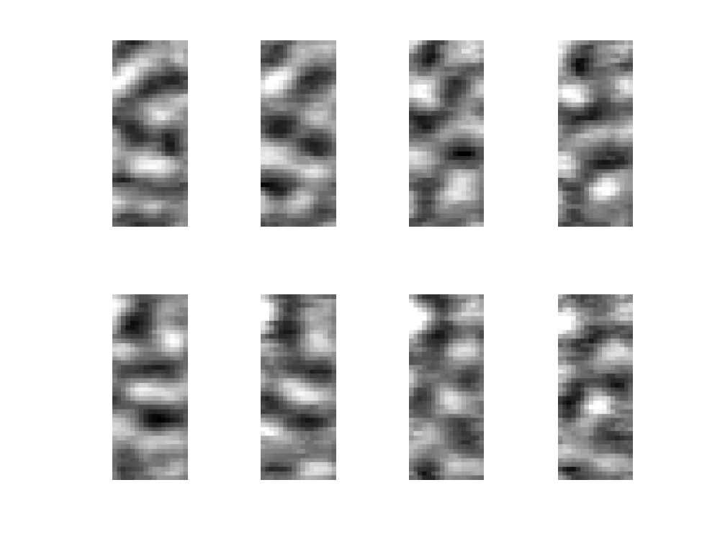
Orientation maps

Slide 10
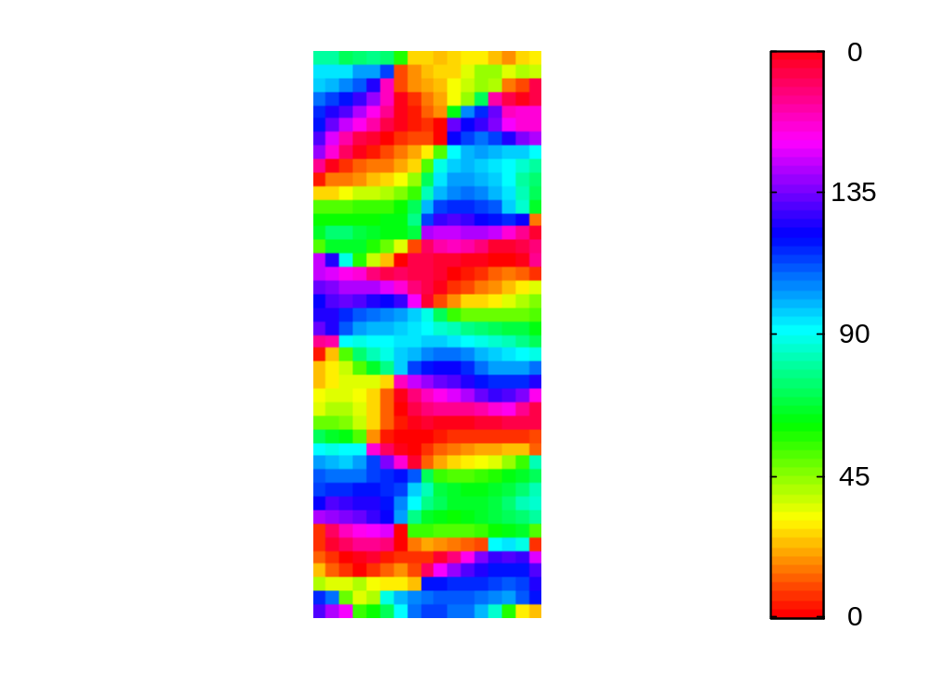
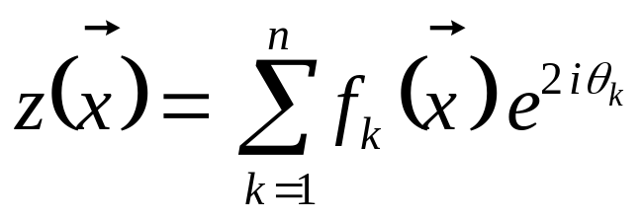
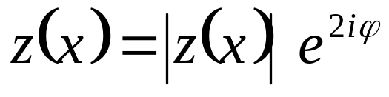
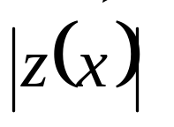
Orientation maps
Preferred orientation φ
Selectivity

Slide 11
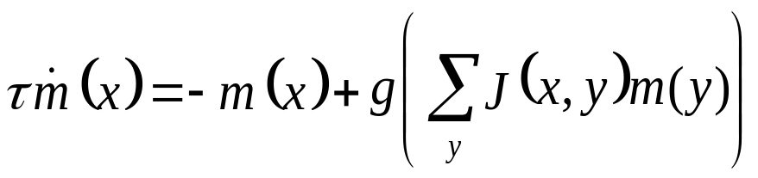
2-D network of visual cortex
(courtesy of Barak Blumenfeld)
g(x)
T

